Slide 1
VIRUS Z
BY Nicole BEBB

Slide 2
INTRODUCTION
Aim of the game is to survive the zombie attack. As you progress through the game more zombies will appear.
The player is equipped with a gun and ammunition.
You must shoot and kill all the zombies; some zombies will take more than one bullet.
If you fail to shot the zombies, and they get close enough, the health bar will go down.
Once your health bar has gone you have failed the game.

Slide 3

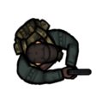

Player & ZOMBIE:

Slide 4
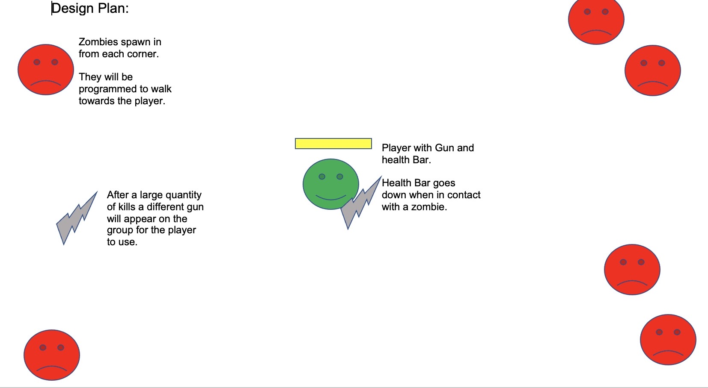
DESIGN 1:

Slide 5
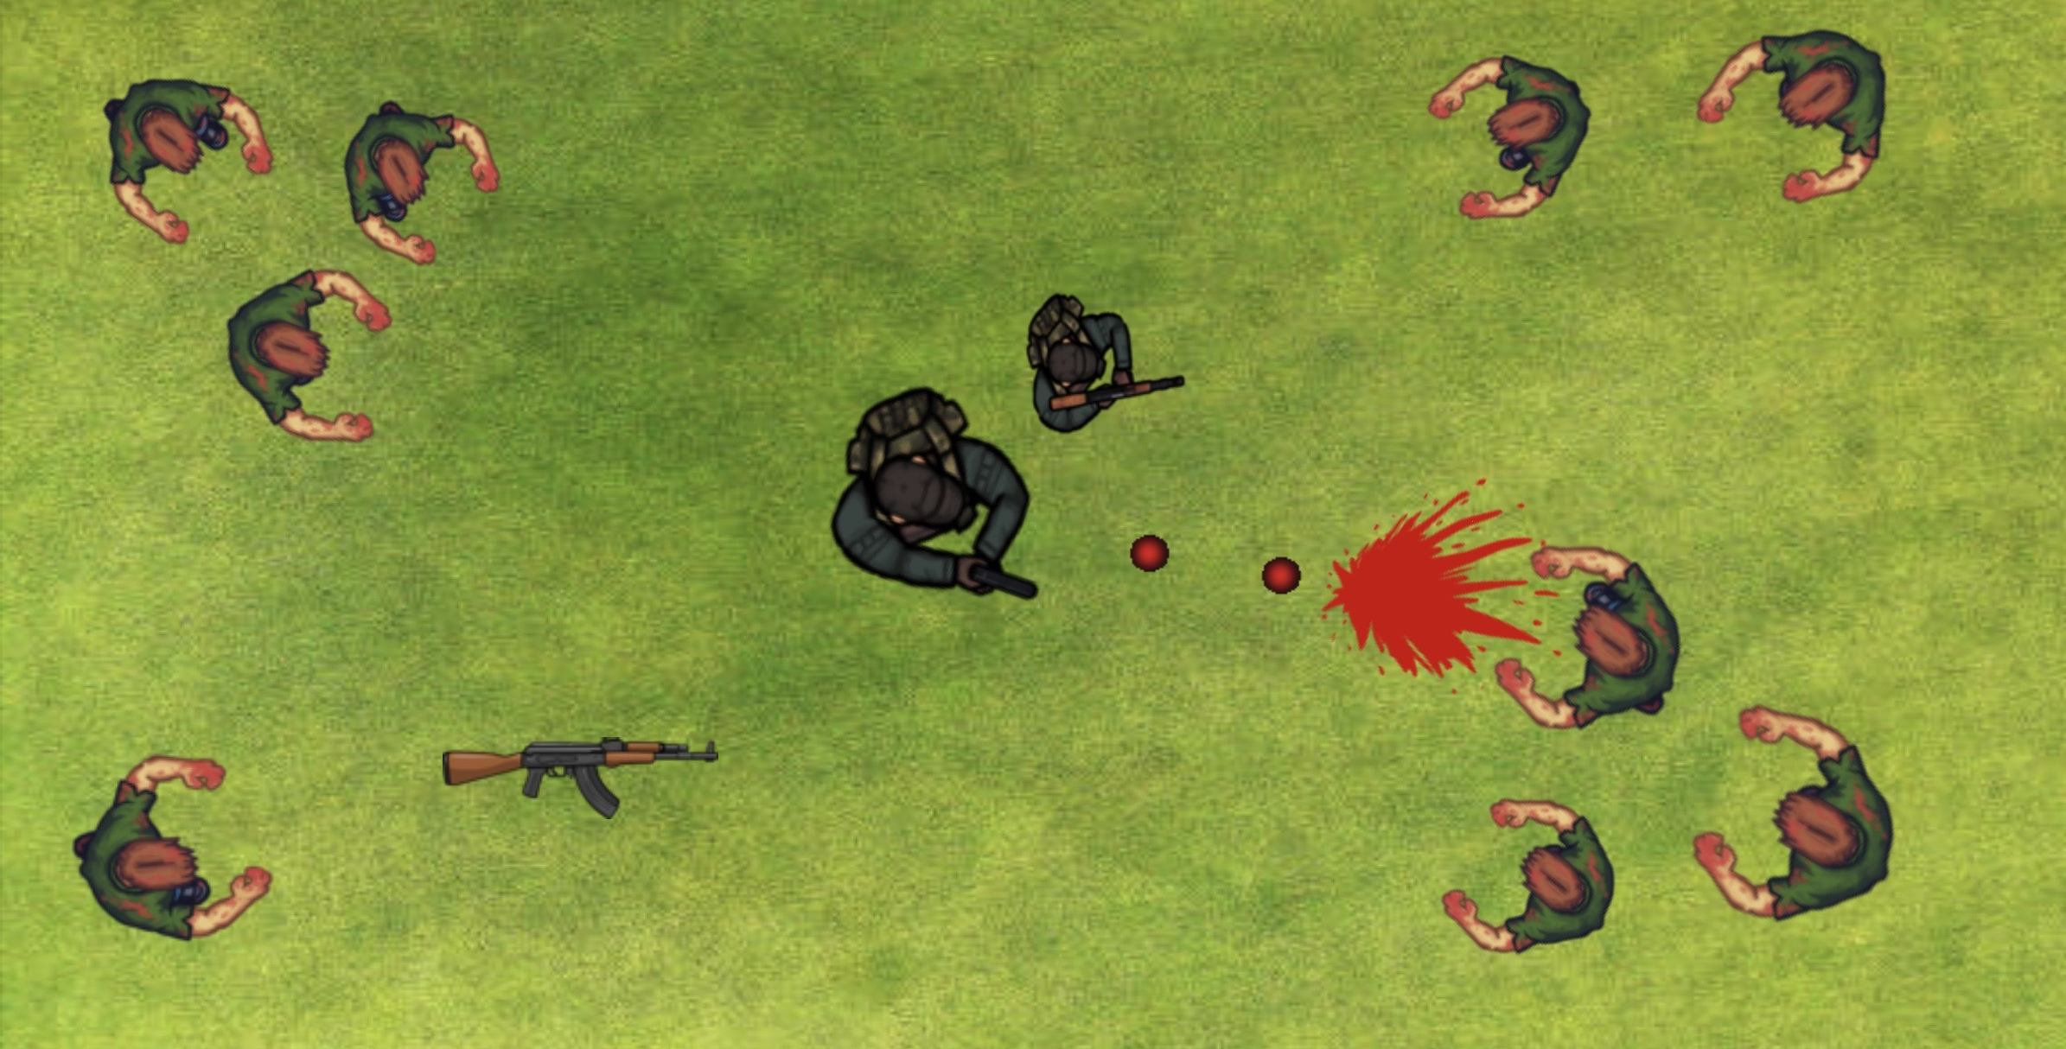
ANIMATED FINAL DESIGN:

Slide 6
DEVELOPMENT PROCESS:
I used Greenfoot to create the game.
I gathered my animations off the internet and put together my design plan.
Issues:
I was unable to set the location of the health bar above the player.
Also was not successful in displaying a "You lose" message when defeated.
Issue I did overcome:
When creating the 'randomSpawn' I couldn’t get the switch statement to compile. I resolved this buy adding 'break;' at the end of each case because the 'break' tells the switch statement to stop executing the code and follow through to the next one.

Slide 7
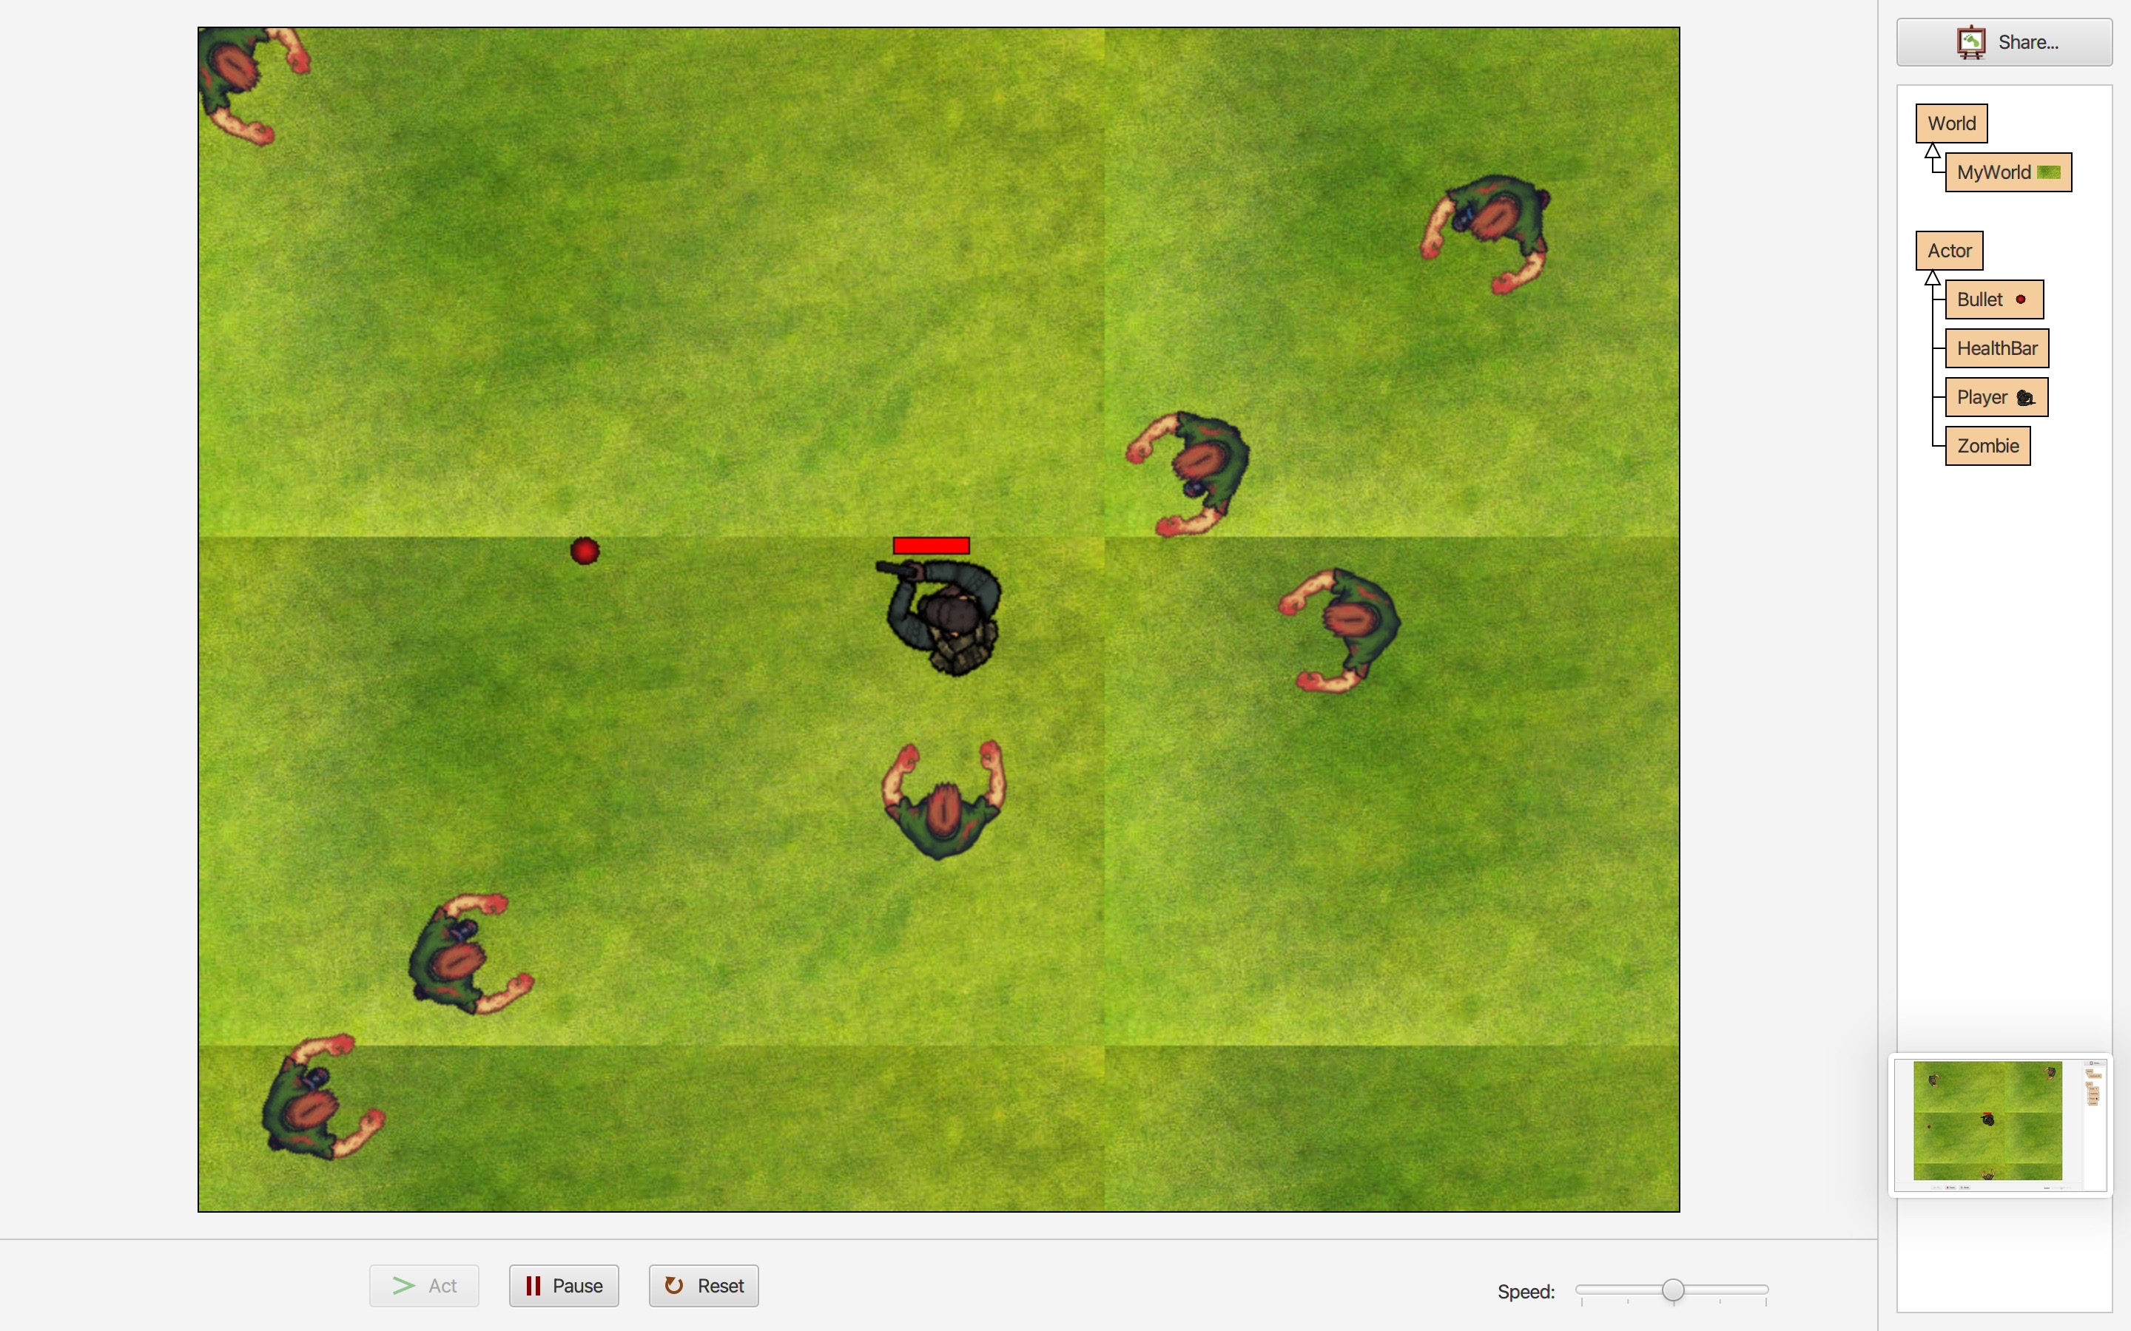
Demonstration:
How to play:
Use mouse to direct the player and aim.
Use W,A,S,D keys for movement.
When you are facing a zombie click your mouse as many times as you like

Slide 8
Evaluation:
Positives:
Overall, the game is success.
Used 17 animated images of the zombie walking worked very well. I did this within an if statement.
I learnt how to create images on Greenfoot. An example is the health bar which is used the code 'getImage' for.
Improvements:
When the bullets are being fired, I would prefer them to look like they were coming out of the gun.
Would also like to create an option to pick up a new gun.

